Slide 1
Rearranging to solve linear equations
Solving linear equations

Slide 2
how to use Oak lessons

Slide 3
I can recognise that equations with unknowns on both sides of the equation can be manipulated so that the unknowns are on one side and then solve this equation.

Slide 4
An equation is used to show two expressions that are equal to each other.
Two expressions form an equality if, when substitution takes place, the expressions have the same value.
Example, substituting x = 5 into 3x − 1 = x + 9
3(5) − 1 = (5) + 9

Slide 5

Rearranging to solve linear equations
Representing equations with unknowns on both sides
Solving equations with unknowns on both sides

Slide 6
Representing equations with unknowns on both sides
Previously, we solved equations like 3𝑥 + 4 = 10
This equation contains an unknown one just one side.
The equation 5𝑥 + 1 = 2𝑥 + 10 contains an unknown on both sides.
Let’s visualise the solution using pan scales.

Slide 7
Representing equations with unknowns on both sides
The equation 5𝑥 + 1 = 2𝑥 + 10 contains an unknown on both sides. Let’s visualise the solution using pan scales.
5x + 1 | = | 2x + 10
5x + 1 | = | 2x + 10
5x + 1 + (−2x) | = | 2x + 10 + (−2x)
5x + 1 | = | 2x + 10
5x + 1 + (−2x) | = | 2x + 10 + (−2x)
3x + 1 | = | 10

Slide 8

Representing equations with unknowns on both sides
The equation 5𝑥 + 1 = 2𝑥 + 10 contains an unknown on both sides. Let’s visualise the solution using pan scales.
5x + 1 | = | 2x + 10
5x + 1 + (−2x) | = | 2x + 10 + (−2x)
3x + 1 | = | 10
5x + 1 | = | 2x + 10
5x + 1 + (−2x) | = | 2x + 10 + (−2x)
3x + 1 | = | 10
3x + 1 + (−1) | = | 10 + (−1)
5x + 1 | = | 2x + 10
5x + 1 + (−2x) | = | 2x + 10 + (−2x)
3x + 1 | = | 10
3x + 1 + (−1) | = | 10 + (−1)
3x | = | 9
x | = | 3
5x + 1 | = | 2x + 10
5x + 1 + (−2x) | = | 2x + 10 + (−2x)
3x + 1 | = | 10
3x + 1 + (−1) | = | 10 + (−1)
3x | = | 9

Slide 9
Representing equations with unknowns on both sides
Let’s study the steps in our solution in more detail.
5x + 1 | = | 2x + 10
5x + 1 + (−2x) | = | 2x + 10 + (−2x)
3x + 1 | = | 10
3x + 1 + (−1) | = | 10 + (−1)
3x | = | 9
x | = | 3
We started with unknowns on both sides.
We manipulated the equation to have the unknowns on only one side.
Then we isolate the unknown.

Slide 10
Representing equations with unknowns on both sides
We can represent the solving of this same equation using a bar model.
x
x
x
x
x
1
5x + 1 | = | 2x + 10
5x + 1 + (−2x) | = | 2x + 10 + (−2x)
3x + 1 | = | 10
3x + 1 + (−1) | = | 10 + (−1)
3x | = | 9
x | = | 3
x
x
10
9
x
x
x
1
10
9
x
x
x

Slide 11
Representing equations with unknowns on both sides
We can represent the solving of this same equation using a bar model.
x
x
x
x
x
1
5x + 1 | = | 2x + 10
5x + 1 + (−2x) | = | 2x + 10 + (−2x)
3x + 1 | = | 10
3x + 1 + (−1) | = | 10 + (−1)
3x | = | 9
x | = | 3
x
x
10
9
x
x
x
1
10
9
3
3
3

Slide 12

Representing equations with unknowns on both sides
Select the most useful first step to solve the equation:
4x + 3 = x + 6
+ (x)
+ (−x)
+ (−4x)

Slide 13
Representing equations with unknowns on both sides
What is a sensible next step to solving?
4x + 3 = x + 6
3x + 3 = 6
+ (−3)
3x = 3
x = 1
+ (3)
+ (−6)

Slide 14
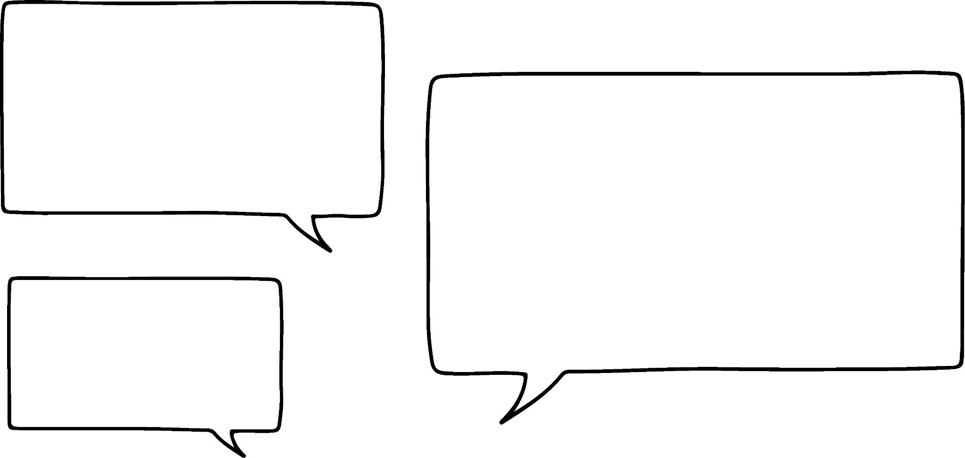


Representing equations with unknowns on both sides
Aisha and Sam are solving the equation x + 13 = 6x + 3
Who is right?
You always have to start with the variable terms so I’m going to add (−x) to both sides.
Both students’ methods work. There are no rules about what you manipulate first.
You don’t have to start with the variable terms. You could manipulate the constants first. I’m going to add (−3) to both sides.

Slide 15
Representing equations with unknowns on both sides
Aisha and Sam are solving the equation x + 13 = 6x + 3
x + 13 | = | 6x + 3
x + 13 | = | 6x + 3
x + 13 + (−x) | = | 6x + 3 + (−x)
13 | = | 5x + 3
x + 13 | = | 6x + 3
x + 13 + (−x) | = | 6x + 3 + (−x)

Slide 16
Representing equations with unknowns on both sides
Aisha and Sam are solving the equation x + 13 = 6x + 3
x + 13 | = | 6x + 3
x + 13 + (−x) | = | 6x + 3 + (−x)
x + 13 | = | 6x + 3
x + 13 + (−x) | = | 6x + 3 + (−x)
13 | = | 5x + 3
13 + (−3) | = | 5x + 3 + (−3)
10 | = | 5x
2 | = | x
x | = | 2
x + 13 | = | 6x + 3
x + 13 + (−x) | = | 6x + 3 + (−x)
13 | = | 5x + 3

Slide 17
Representing equations with unknowns on both sides
Aisha and Sam are solving the equation x + 13 = 6x + 3
x + 13 | = | 6x + 3
x + 13 + (−3) | = | 6x + 3 + (−3)
x + 13 | = | 6x + 3
x + 13 + (−3) | = | 6x + 3 + (−3)
x + 13 | = | 6x + 3
x + 13 + (−3) | = | 6x + 3 + (−3)
x + 10 | = | 6x

Slide 18
Representing equations with unknowns on both sides
Aisha and Sam are solving the equation x + 13 = 6x + 3
x + 13 | = | 6x + 3
x + 13 + (−3) | = | 6x + 3 + (−3)
x + 13 | = | 6x + 3
x + 13 + (−3) | = | 6x + 3 + (−3)
x + 13 | = | 6x + 3
x + 13 + (−3) | = | 6x + 3 + (−3)
x + 10 | = | 6x
x + 10 + (−x) | = | 6x + (−x)
10 | = | 5x
2 | = | x
x | = | 2
x + 13 | = | 6x + 3
x + 13 + (−3) | = | 6x + 3 + (−3)
x + 10 | = | 6x

Slide 19

Representing equations with unknowns on both sides
Let’s compare the two methods.
x + 13 | = | 6x + 3
x + 13 + (−x) | = | 6x + 3 + (−x)
13 | = | 5x + 3
13 + (−3) | = | 5x + 3 + (−3)
10 | = | 5x
x | = | 2
x + 13 | = | 6x + 3
x + 13 + (−3) | = | 6x + 3 + (−3)
x + 10 | = | 6x
x + 10 + (−x) | = | 6x + (−x)
10 | = | 5x
x | = | 2
What do you notice?
Same steps, different order
Different methods, same result
Same steps, different order
Aisha
Sam

Slide 20
Representing equations with unknowns on both sides
True, but this can still be obtained after manipulating constants first.
Two different methods, same result.
When solving the equations you have to manipulate the variable terms first.
We need the unknowns on one side in order to solve.
You can start by manipulating either the variable terms, or the constant terms.

Slide 21
Representing equations with unknowns on both sides
1) Build an equation with unknowns on both sides.
Starting with this balance showing 2x = 8 show what you need to add to both sides to make the equation 7x + 2 = 5x + 10
2x | = | 8

Slide 22
Representing equations with unknowns on both sides
2) ‘Undo’ this balance model to solve this equation.
Write your algebraic notation alongside.
6x + 4 | = | 3x + 10

Slide 23
Representing equations with unknowns on both sides
3) Use this bar model to solve this equation.
Write your algebraic notation alongside.
2x + 161 | = | 8x + 29
x
x
161
x
x
x
x
x
x
x
x
29

Slide 24
Representing equations with unknowns on both sides
1) Build an equation with unknowns on both sides.
Starting with this balance showing 2x = 8 show what you need to add to both sides to make the equation 7x + 2 = 5x + 10
2x | = | 8
2x | = | 8
2x + (5x) | = | 8 + (5x)
7x | = | 5x + 8
7x + (2) | = | 5x + 8 + (2)
7x + 2 | = | 5x + 10
2x | = | 8
2x + (5x) | = | 8 + (5x)
7x | = | 5x + 8

Slide 25
Representing equations with unknowns on both sides
2) ‘Undo’ this balance model to solve this equation.
6x + 4 | = | 3x + 10
6x + 4 + (−3x) | = | 3x + 4 + (−3x)
3x + 4 | = | 10
6x + 4 | = | 3x + 10

Slide 26
If you manipulated the constants first and still arrived at the same result that is fine!
Representing equations with unknowns on both sides
2) ‘Undo’ this balance model to solve this equation.
6x + 4 | = | 3x + 10
6x + 4 + (−3x) | = | 3x + 4 + (−3x)
3x + 4 | = | 10
3x + 4 + (−4) | = | 10 + (−4)
3x | = | 6
6x + 4 | = | 3x + 10
6x + 4 + (−3x) | = | 3x + 4 + (−3x)
3x + 4 | = | 10
6x + 4 | = | 3x + 10
6x + 4 + (−3x) | = | 3x + 4 + (−3x)
3x + 4 | = | 10
3x + 4 + (−4) | = | 10 + (−4)
3x | = | 6
x | = | 2

Slide 27
Representing equations with unknowns on both sides
3) Use this bar model to solve this equation.
Write your algebraic notation alongside.
2x + 161 | = | 8x + 29
x
x
161
x
x
x
x
x
x
x
x
29
161 | = | 6x + 29
161
x
x
x
x
x
x
29
132 | = | 6x
132
x | = | 22

Slide 28
Rearranging to solve linear equations
Representing equations with unknowns on both sides
Solving equations with unknowns on both sides

Slide 29


Solving equations with unknowns on both sides
Solve x + 3 = 2x − 4
I’m not sure how to deal with negatives.
Here. Let me show you!
Now you add positives to ‘undo’ the negatives.
Andeep
Now it’s all positive!
Laura
x + 3 = 2x − 4
x + 3 + (4) = 2x − 4 + (4)
x + 7 = 2x
x = 7

Slide 30
Solving equations with unknowns on both sides
Select the most useful first step to solve the equation:
x + 3 = 4x − 6
+ (3)
+ (−6)
x + 3 + (6) = 4x − 6 + (6)
x + 9 = 4x
+ (6)
9 = 3x
x = 3

Slide 31
Solving equations with unknowns on both sides
Solve x + 3 = 2x − 4
Can you do negatives with bar models?
Absolutely! It’s more difficult to set them up but if you master it they can be easier to solve!
The negative goes in the negative direction.
Andeep
x
3
4
That’s 2x − 4
Laura
x
x
x = 7

Slide 32
Solving equations with unknowns on both sides
Which equation does this bar model represent?
x
13
5
x + 13 = 3x − 5
x
x
x
x
13
5
x + 18 = 3x
x
x
x
13
5
2x = 18
x
x

Slide 33
Solving equations with unknowns on both sides
Which equation does this bar model represent?
These answers were the steps to solving the equation!
x + 13 = 3x − 5
x + 13 = 3x − 5
x + 13 + (5) = 3x − 5 + (5)
x + 18 = 3x
x + 18 = 3x
x + 18 + (−x) = 3x + (−x)
2x = 18
2x = 18
x = 9

Slide 34
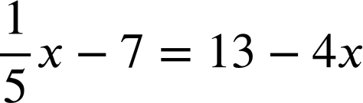
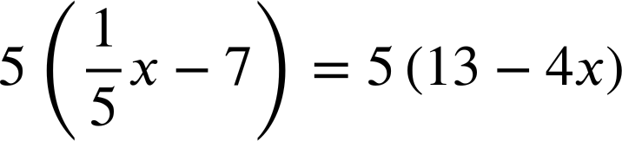

Solving equations with unknowns on both sides
Sometimes a model is inappropriate. In this case we use our fluency in manipulation.
Multiplying both sides by (+5) means we no longer have a fraction in our equation.
x − 35 | = | 65 − 20x
21x − 35 | = | 65
x − 35 | = | 65 − 20x
x − 35 | = | 65 − 20x
21x − 35 | = | 65
21x | = | 100
Adding (+20x) to both sides means we now have a positive unknown term on one side.

Slide 35
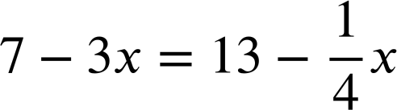

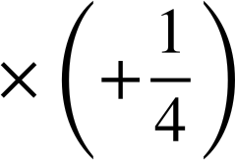

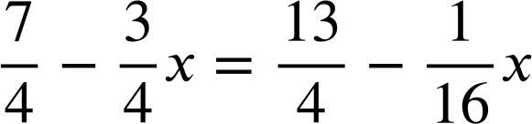

Solving equations with unknowns on both sides
Select a useful first step to solve the equation:
This is not an efficient start.

Slide 36
Solving equations with unknowns on both sides
Select a useful first step to solve the equation:
A very efficient start.
Arguably even more efficient!
28 − 12x = 52 − x
12x − 28 = x − 52

Slide 37
Solving equations with unknowns on both sides
1) Solve these equations in two different ways:
3x + 2 | = | 7x − 10
3x + 2 | = | 7x − 10
a)
2x + 2 | = | 23 − 5x
2x + 2 | = | 23 − 5x
b)

Slide 38
Solving equations with unknowns on both sides
2) Find the perimeter of this rectangle.
17 − 2x
7
3x + 2

Slide 39
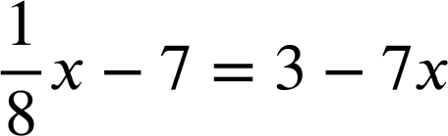
Solving equations with unknowns on both sides
3) Solve:

Slide 40
There were multiple other methods you might have used which should have led to the same solution.
Solving equations with unknowns on both sides
1) Solve this equation in two different ways:
3x + 2 | = | 7x − 10
3x + 2 + (−3x) | = | 7x − 10 + (−3x)
2 | = | 4x − 10
2 + (10) | = | 4x − 10 + (10)
12 | = | 4x
x | = | 3
3x + 2 | = | 7x − 10
3x + 2 + (10) | = | 7x − 10 + (10)
3x + 12 | = | 7x
3x + 12 + (−3x) | = | 7x + (−3x)
12 | = | 4x
x | = | 3
a)

Slide 41
There were multiple other methods you might have used which should have led to the same solution.
Solving equations with unknowns on both sides
1) Solve this equation in two different ways:
2x + 2 | = | 23 − 5x
2x + 2 + (5x) | = | 23 − 5x + (5x)
7x + 2 | = | 23
7x + 2 + (−2) | = | 23 + (−2)
7x | = | 21
x | = | 3
2x + 2 | = | 23 − 5x
2x + 2 + (−2) | = | 23 − 5x + (−2)
2x | = | 21 − 5x
2x + (5x) | = | 21 − 5x + (5x)
7x | = | 21
x | = | 3
b)

Slide 42
Solving equations with unknowns on both sides
2) Find the perimeter of this rectangle.
17 − 2x
17 − 2x | = | 3x + 2
17 − 2x + (2x) | = | 3x + 2 + (2x)
17 | = | 5x + 2
17 + (−2) | = | 5x + 2 + (−2)
15 | = | 5x
x | = | 3
7
3x + 2
3(3) + 2 = 11
Perimeter = 2(11 + 7) = 2(18) = 36

Slide 43
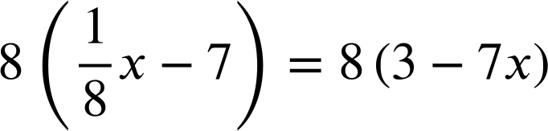
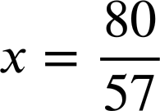
Solving equations with unknowns on both sides
3) Solve:
x − 56 | = | 24 − 56x
57x − 56 | = | 24
57x | = | 80

Slide 44
Rearranging to solve linear equations
Equations with unknowns on both sides can be manipulated in many ways so that the unknowns are on one side and we can therefore solve.

Slide 45

© Oak National Academy 2023.
Produced in partnership with Mathematics in Education and Industry.
Licensed on the Open Government Licence v3.0, except where otherwise stated. See Oak terms and conditions.

